Slide 1
Developmental Interventions for Minorities in Post-Sachar Era
Abdul Shaban
Tata Institute of Social Sciences
(shaban@tiss.edu)

Slide 2
Introduction
The major planes along which the socio-economic inequity in India have been found are caste, tribe, religion, gender, and region.
Caste and region have been taken into account while decision making. Religion has been a major dimension along which the affirmative actions have been slow or non-starter.
The lower caste from the specific religious communities have not been found in the affirmative actions and reservation in government jobs.

Slide 3
….Introduction
The exclusion from the SC list has enormous impact especially on Muslims who substantial population belong to the lower castes.
For Muslims, in this challenging socio-economic situation development of Muslims cannot be imagined without affirmative action
Pathetics situation of Muslims: The Gopal Singh Committee in early 1980 but its findings and recommendations lost in the politics of communalism.
After more than two decades, Sachar Committee Report (SCR) in 2006,

Slide 4
WW Hunter’s Study of Muslims’ Exclusion
The proportion of the race a century ago had the monopoly of Government, has now fallen to less than one-twenty-third of the whole administrative body. This too, in the gazette appointments, where the distribution of patronage is closely watched. In the less conspicuous office establishments in the Presidency Town, the exclusion of the Mussalmans is even more complete. In one extensive department on the other day it was discovered that there was not a single employee who could read the Mussalman dialect; and, in fact, there is now scarcely a government office of Calcutta in which a Muhammeden can hope for any post above the rank of porter, messenger, filler of inkpots and mender of pens” (Hunter 2002:162).

Slide 5
Rural Areas Poverty by Religious Groups
Religious groups | 1993-94 | 2004-05 | 2009-10
Buddhists | 73.2 | 65.8 | 44.1
Christians | 44.9 | 29.8 | 23.8
Hindus | 50.3 | 42 | 33.5
Muslims | 53.5 | 44.6 | 36.2
Jains | 24.3 | 10.6 | 0.0
Sikhs | 19.6 | 21.8 | 11.8
Total | 50.1 | 41.9 | 33.3

Slide 6
Urban Areas Poverty among Religious Groups
Religious groups | 1993-94 | 2004-05 | 2009-10
Buddhists | 47.2 | 40.4 | 31.2
Christians | 22.6 | 14.4 | 12.9
Hindus | 29.5 | 23.1 | 18.7
Muslims | 46.4 | 41.9 | 34.0
Jains | 5.5 | 2.7 | 1.7
Sikhs | 18.8 | 9.5 | 14.5
Total | 31.7 | 25.8 | 20.9

Slide 7
Rural+Urban Areas Poverty among Religious Groups
Religious groups | 1993-94 | 2004-05 | 2009-10
Buddhists | 64.9 | 56 | 39.0
Christians | 38.4 | 25 | 20.5
Hindus | 45.4 | 37.5 | 29.7
Muslims | 51.1 | 43.7 | 35.5
Jains | 10.2 | 4.6 | 1.5
Sikhs | 19.4 | 19 | 12.5
Total | 45.5 | 37.8 | 29.9

Slide 8
Urban Areas Ratio between Muslim Poverty and Overall Poverty in respective states
States | 1993-94 | 2004-05 | 2009-10
Andhra Pradesh | 1.30 | 1.40 | 1.40
Assam | 1.80 | 1.10 | 2.00
Bihar | 1.30 | 1.40 | 1.40
Gujarat | 1.60 | 2.10 | 2.40
Haryana | 2.10 | 2.10 | 1.80
Jharkhand | 1.30 | 2.10 | 1.40
Karnataka | 1.50 | 1.60 | 1.00
Kerala | 1.20 | 1.30 | 1.40
Madhya Pradesh | 1.10 | 1.40 | 1.40
Maharashtra | 1.50 | 1.90 | 1.70
Punjab | 1.90 | 2.20 | 1.30
Rajasthan | 1.80 | 1.40 | 1.50
Tamil Nadu | 1.10 | 1.00 | 0.90
Uttar Pradesh | 1.30 | 1.40 | 1.60
Uttarakhand | 1.70 | 1.70 | 2.00
West Bengal | 1.80 | 1.90 | 1.60
Total | 1.50 | 1.60 | 1.60

Slide 9
Percentage of population with various levels of education by religion in India, 2011
Levels of Education | Hindu | Muslim | Christian | Sikh | Buddhist | Jain
 | Total
Literate without educational level | 2.88 | 2.90 | 3.53 | 2.15 | 3.46 | 3.29
Below primary | 11.83 | 14.32 | 11.95 | 8.04 | 14.32 | 7.36
Primary | 15.11 | 16.08 | 14.65 | 15.66 | 14.37 | 10.29
Middle | 11.27 | 9.73 | 12.35 | 11.19 | 13.04 | 8.82
Matric | 9.00 | 6.33 | 10.08 | 14.78 | 10.93 | 15.48
SSC | 6.62 | 4.44 | 10.32 | 8.25 | 8.61 | 14.05
Non-tech dip/certificate | 0.07 | 0.17 | 0.18 | 0.08 | 0.04 | 0.19
Tech dip/certificate | 0.61 | 0.27 | 2.23 | 0.79 | 0.47 | 1.10
Graduate & above | 5.98 | 2.76 | 8.85 | 6.40 | 6.18 | 25.65

Slide 10
Percentage of population with various levels of education by religion in India, 2011
 | Males
 | Hindu | Muslim | Christian | Sikh | Buddhist | Jain
Literate without educational level | 3.06 | 3.15 | 3.52 | 2.17 | 3.44 | 3.15
Below primary | 12.24 | 15.06 | 12.09 | 8.75 | 14.85 | 6.71
Primary | 15.84 | 16.98 | 15.14 | 15.53 | 14.36 | 8.62
Middle | 12.75 | 10.80 | 13.26 | 12.06 | 14.25 | 8.46
Matric | 10.61 | 7.16 | 10.72 | 16.64 | 12.29 | 16.13
SSC | 7.77 | 4.95 | 10.24 | 8.89 | 10.02 | 15.15
Non-tech dip/certificate | 0.10 | 0.19 | 0.23 | 0.08 | 0.05 | 0.20
Tech dip/certificate | 0.90 | 0.39 | 2.39 | 0.94 | 0.67 | 1.59
Graduate & above | 7.24 | 3.41 | 8.98 | 6.10 | 7.51 | 27.66

Slide 11
Percentage of population with various levels of education by religion in India, 2011
 | Females
 | Hindu | Muslim | Christian | Sikh | Buddhist | Jain
Literate without educational level | 2.68 | 2.64 | 3.55 | 2.13 | 3.48 | 3.43
Below primary | 11.40 | 13.53 | 11.81 | 7.25 | 13.78 | 8.04
Primary | 14.34 | 15.14 | 14.17 | 15.80 | 14.39 | 12.04
Middle | 9.69 | 8.61 | 11.46 | 10.23 | 11.79 | 9.20
Matric | 7.28 | 5.45 | 9.45 | 12.71 | 9.51 | 14.81
SSC | 5.39 | 3.89 | 10.39 | 7.55 | 7.15 | 12.90
Non-tech dip/certificate | 0.04 | 0.15 | 0.14 | 0.08 | 0.02 | 0.17
Tech dip/certificate | 0.30 | 0.14 | 2.06 | 0.63 | 0.27 | 0.59
Graduate & above | 4.64 | 2.07 | 8.72 | 6.73 | 4.80 | 23.55

Slide 12
Justice Sachar Committee Report (2006)
The Committee raise the issues related to
Identity
Security and
Equity of Muslims
The Committee advocated
equality of opportunity for Muslims,
non-discriminatory policies, and
For this setting up of an Equal Opportunity Commission and adoption of Diversity Index based interventions in public and private domains (Government of India 2006).

Slide 13
Post-Sachar Initiatives
Revamped the Prime Minister’s 15 Point Programme (PM15PP) in 2006
Multi-sectoral Development Programme (MsDP) 2007-08
These two programmes, PM15PP and MsDP, constitute the backbone of major initiatives
Post-Sachar affirmative action significant because, no development plan was launched for religious minorities until the Eleventh Five Year Plan.
This presentation an attempt to assess the effectiveness of central sector schemes, the PM15PP and MsDP in the country, and progress in building institutions for development of minorities in Post-Sachar years.
Some states like Telangana, West Bengal, Kerala, Uttar Pradesh, Maharashtra, etc, have introduced their specific schemes for development of minorities but due to lack of time I do not cover them

Slide 14
Organization of presentation
The presentation is divided into 6 Sections.
A brief introduction to PM15PP and MsDP while
The achievements and targets under PM15PP and MsDP.
Other new schemes by the MoMA
Institution building by the Government of India for development and empowerment of minorities
Presidential Order 1950
The last section Sums up the discussion

Slide 15
Prime Minister’s 15 Point Programme and MsDP
The PM15PP, revamped and recasted in 2006, aims to spend 15% of the plan outlays in minority concentrated areas
The major objectives of this programme are
to enhance opportunities for education to minorities
to ensure equitable Share in Economic Activities and Employment to minorities
to improve the condition of living of minorities
to prevent and control communal Riots through measures aimed at
(xiii) prevention of communal incidents by posting police officials with secular records in sensitive and riot prone districts/areas and linking this to the career promotion of District Magistrates and Superintendent of Police,
(xiv) prosecution for communal offence,
(xv) rehabilitation of victims of communal riots.

Slide 16
MsDP
MSDP was initiated in 2008-09 in 90 minority concentrated districts (MCDs).
It is the largest ever programme for the development of the minorities since the Independence.
This is largely an area development scheme and is intended to provide additional/gap filling funds to the existing centrally sponsored schemes (CCS) and particularly the PM15PP.
In 12th Five Year Plan, the unit of implementation of MsDP are minority concentrated blocks and cluster of minority concentrated villages instead of districts.
This helps in covering the minority concentrated blocks (MCBs) lying outside the MCDs.
Total of 710 MCBs,
about 500 villages falling outside the MCBs,
and 66 minority concentrated towns have been identified for the implementation of the programme.

Slide 17
Working of PM15PP

Slide 18
Enhancement of opportunities for education
Although ICSSR (Reddy 2008) has done baseline survey for MCDs, no systematic figures of developmental gaps have been provided.

Slide 19
ICDS
Scheme not able to use allocated resources.
Decline in establishment of ICDS Cenres over the years
Year | 2006-07 | 2007-08 | 2008-09 | 2009-10 | 2010-11 | 2011-12 | 2012-13
% achievement | 39.0 | 83.5 |  | 65.9 | 45.3 | 40.8 | 74.0
Total achievement (in No.) | 11125 | 21014 |  | 23712 | 6934 | 3489 | 3804

Slide 20
Schools Opened (Achievements of targets %)
Varied achievements of targets

Slide 21
Schools constructed (Achievements of targets %)
Varied achievements

Slide 22
Class rooms constructed (Achievements of targets %)
Filling of post of teachers experienced very low achievements in recent years

Slide 23
KGBV Sanctioned (Achievements of targets %)
A good achievements visible

Slide 24
Achievements and targets in filling the post of teachers under SSA
Year | 2006-07 | 2007-08 | 2008-09 | 2009-10 | 2010-11 | 2011-12
% achievement | 91.5 | 116.0 | 71.8 | 91.9 | 72.8 | 23.6
Total achievement (in No.) | 24282 | 24866 | 15759 | 7743 | 34941 | 7603
Filling of post of teacher declines

Slide 25
Modernization of Madarsa Education Programme
Amount sanction :
Rs. 42.52 crore in 2009-10 and
Rs. 139.53 crore in 2011-12
Among the states, the major share of the money went to Uttar Pradesh (total sanctioned amount was Rs. 31.9 crore in 2009-10 and 111.75 core in 2011-12)
Total Rs.182.73 crore was released for 14,859 Madarsas involving 35,376 teachers in 2013-14.

Slide 26
Pre-Matric Scholarships
Significant rise in target over the years 2008-09 to 2013-14
Target 3 lakh scholarship in 2008-09 which has increased to 40 lakh each in 2012-13 and 2013-14
The achievement has ranged from 115% to 221% during the period.
The total amount of financial resources allocated for the scholarship has also gone up from mere
Rs.62.21 crore in 2008-09
to Rs.963.70 crore in 2013-14.
Each of the five minority religious communities have had their fixed share in allocation of targets: Muslims 72.9%, Christians 12.7%, Sikhs 10.1%, Buddhists 4.2% and Parsis less than 1%, determined based on their shares in minority population.

Slide 27
Post-matric Scholarship
Significant Increase during 2008-09 to 2012-13.
The targeted number of post-matric scholarship was
75 thousand in 2008-09
5 lakh each in 2011-12, 2012-13 and 2013-14.
Achievement of targets by the government has been more than 100% in all the financial years
and has ranged from 121% to 178% over the years.
OVERALL
that the achievement of physical targets under the Scholarship Schemes have been very satisfactory.

Slide 28
Merit-cum-mean scholarship
Rose from mere 20 thousand in 2006-07 to 60 thousand in 2012-13.
The percentage achievements of targets for the scholarships for Muslims, Christians and Sikhs have been above 100% in most of the financial years

Slide 29
Utilization of funds under Scholarships
The Pre-Matric Scholarship: utilize only 94.81% of the total allocation (of Rs.1400 crore) in the Eleventh Five Year Plan,
Post-Matric Scholarship: 71.38% of the allocation (Rs.1150 crore)
Merit-cum-Mean Scholarship: 71.23% of the allocation (Rs.600).
Only Free Coaching Scheme: utilization was 121.36% (total allocation was Rs.45 crore)
It is not clear why this mismatch between physical and financial achievements occurred
May be given to income groups that require lower fees.

Slide 30
Maulana Azad National Fellowship
It provides integrated five year fellowships to students from minority community (for MPhil and PhD).
Data available show that the
total fresh fellowships awarded under MANF was 757 in 2009-10,
747 in 2010-11,
757 in 2011-12, and
the renewal numbers are 757 in 2010-11 and 1,511 in 2011-12
70% of these fellowships have gone to Muslim students.

Slide 31
Share in Economic Activity and Employment
Recruitment share of minorities (Muslims, Christians, Sikhs, Buddhists, Parsis and Jains) less than their share in total population (about 18.5%).
It was
8.3% in 2006-07,
12.75% in 2008-09
8.22% in 2009-10 and
4.10% in 2011-11.
PM 15 Programme guidelines are not able to make any real impact?

Slide 32
Enhancement of Financial Credit

Slide 33
Amount Disbursed and Number of Beneficiaries of Micro-Credit Scheme of
Year | Amount disbursed(In Rs. Crores) | No. of Beneficiaries
1998-99 | 0.43 | 3,281
1999-00 | 0.52 | 7,359
2000-01 | 1.00 | 11,418
2001-02 | 4.78 | 24,529
2002-03 | 2.90 | 7,540
2003-04 | 4.42 | 9,415
2004-05 | 8.29 | 11,034
2005-06 | 10.01 | 10893
2006-07 | 13.17 | 25482
2007-08 | 13.22 | 16159
2008-09 | 15.93 | 16213
2009-10 | 58.73 | 73702
2010-11 | 103.79 | 129742
2011-12 | 159.38 | 88702
2012-13 | 186.7 | 82974
2013-14 | 122.96 | 54648
Total | 706.22 | 573095
Not much relevance of NMDFC as the amount disburse is quite small.
The Government needs to enhance the amounts available to NMDFC for lending to minorities

Slide 34
Priority Sector Lending by Commercial Banks
The PM’s 15 Point Programme advocates for a certain share of priority sector lending for minorities.
The amount disbursed to minorities under priority sector lending was
Rs.58,663 crore in 2007-08,
Rs.1,64,748 crore in 2011-12, almost 3 times increase in 4 years.
The share of credit lent to minorities under priority sector lending has ranged between
7.5% in 2006-07 to 11.3% in 2012-13.
This is much lower than the % of minority population in the country.
Muslims are not the major beneficiaries of priority sector lending.
In 2013-14, Muslims could get only 44.31%,
while Sikh had 24.58%, Christian 21.87%, Buddhists 2.06%, Parsis 2.23% and Jains 4.96% in total PSL to minorities in the same year.

Slide 35
BSUP and IHSDP
Debate on the ways data on expenditures under the JnNURM reported by the related department/ministries.
Investments made in any part of minority concentrated town have been highlighted as if the major improvement has taken place in the areas where minority community resides.
As the area wise data of the investments for the cities are not available, one is no position to verify the claim/statistics.
At the national level, more than 20% of the total money allocated under the two sub-mission of JnNURM have gone to the towns and cities with substantial minority population.
In actual terms, the investment was to the tune of
Rs.6,368.52 crore in 2007-08
Rs.7,254.84 crore in 2012-13

Slide 36
Communal Harmony
security and development are essential to the goals of inclusion and social justice,
the PMs New 15 Point Programme commits to – Prevention of communal incidents (point 13) Prosecution for communal offences (point 14), and Rehabilitation of victims of communal riots (point 15)
We find this commitment has been repeatedly breached.
Incidents of communal violence continue to occur creating an environment of deep insecurity among minorities

Slide 37
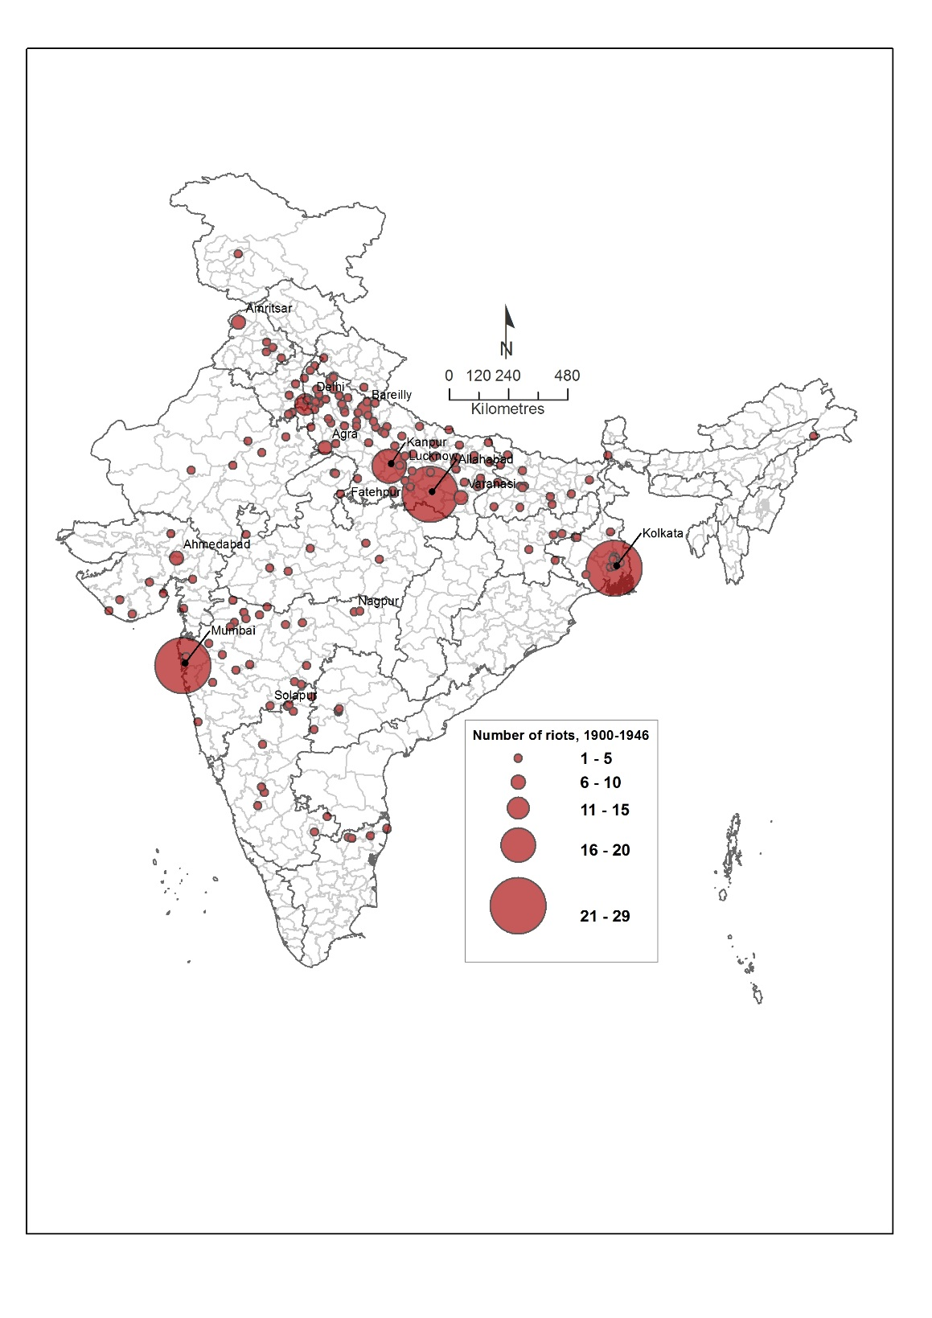
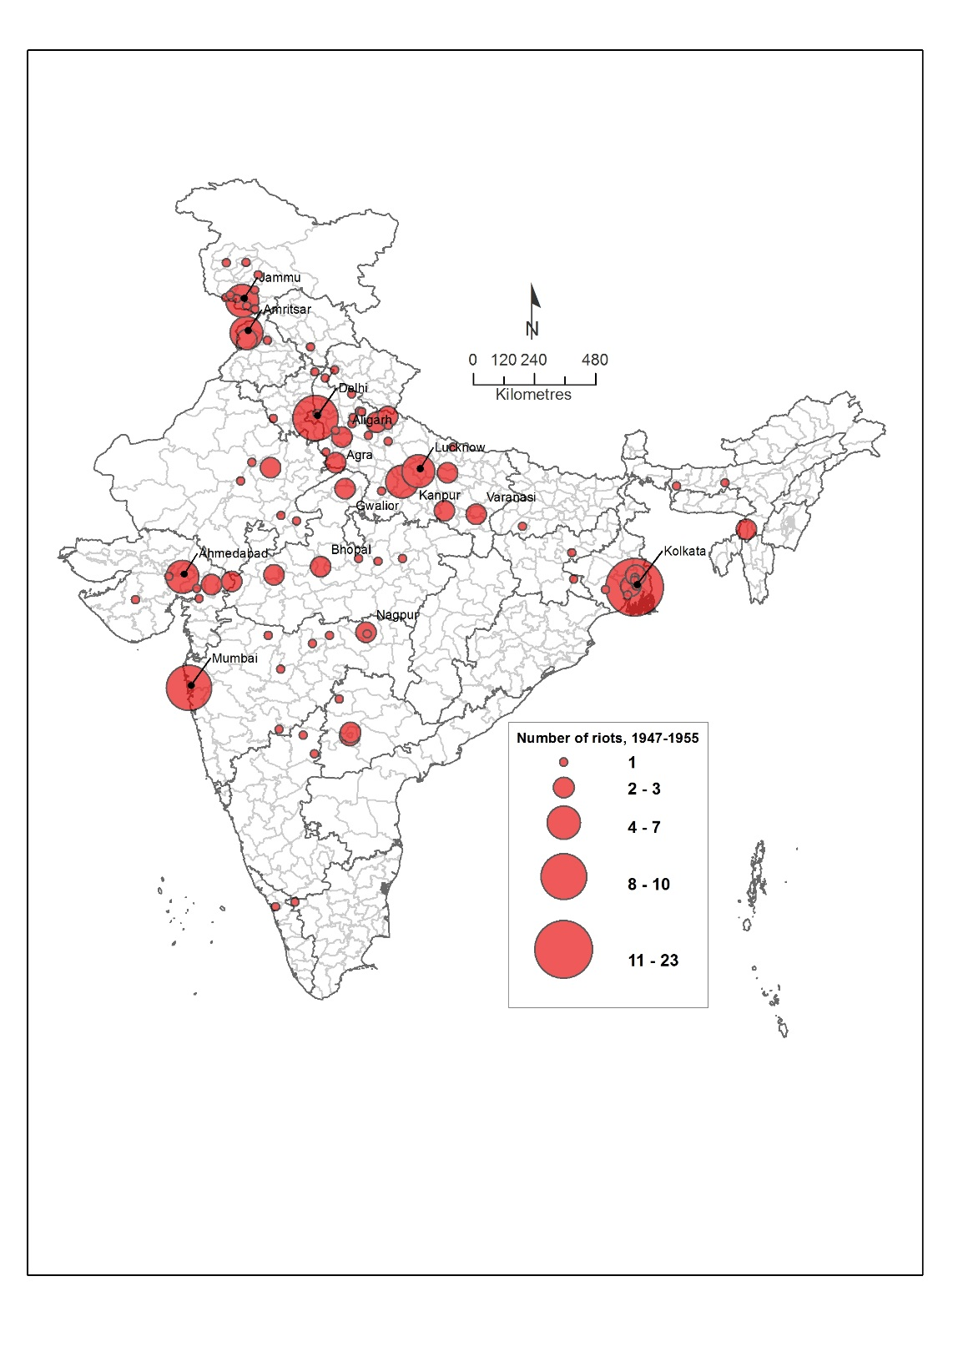
Number of riots, 1900-1946
Number of riots, 1947-1955

Slide 38
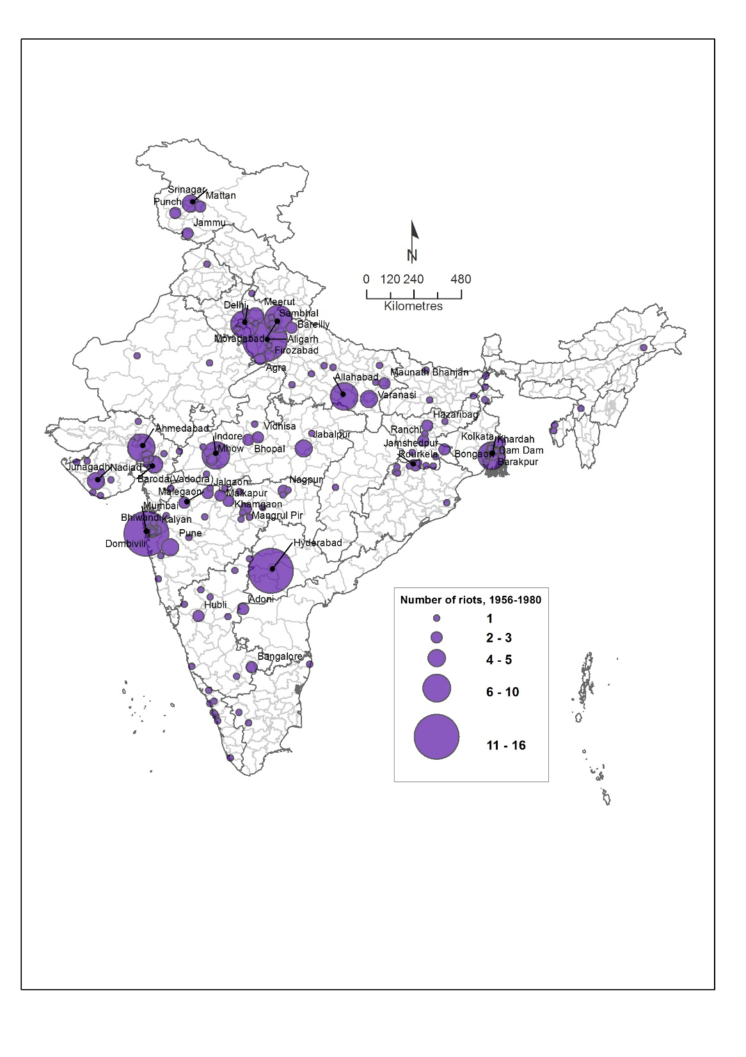
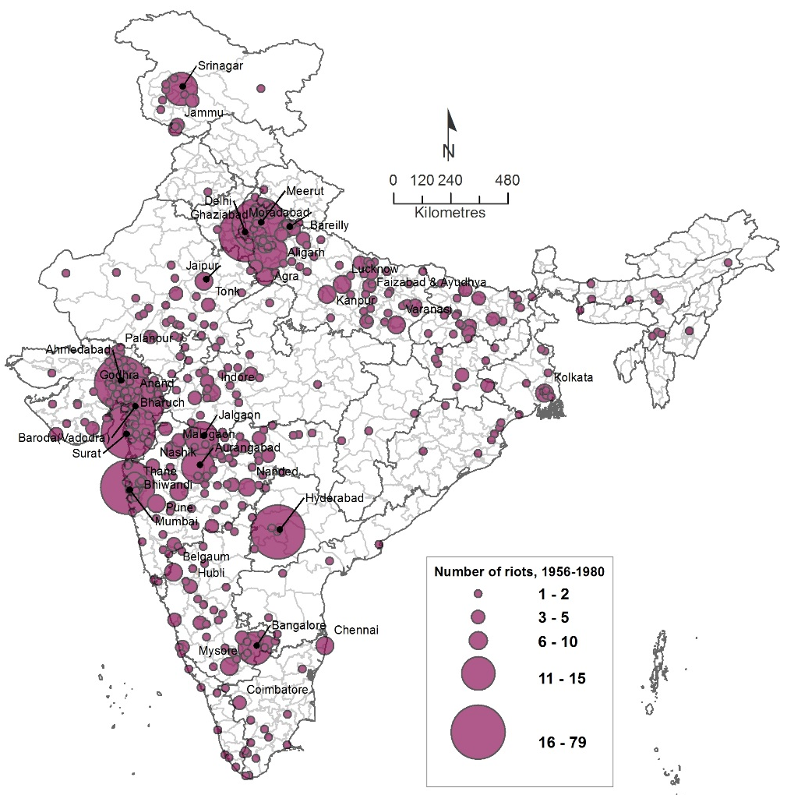
Number of riots, 1956--1980
Number of riots, 1981-2013

Slide 39
Top Five cities in riots
1901-1946
Rank | Town/city | No. of incidence | Town/city | Persons killed | Town/city | Persons injured | Town/city | Duration (Days)
 | Total | 405 | Total | 6755 | Total | 26609 | Total | 527
1 | Mumbai | 29 | Kolkata | 4290 | Kolkata | 12415 | Mumbai | 128
2 | Kolkata | 26 | Mumbai | 844 | Mumbai | 5761 | Kolkata | 92
3 | Allahabad | 22 | Kanpur | 428 | Kanpur | 962 | Allahabad | 26
4 | Kanpur | 19 | Garmukteswar | 214 | Ahmedabad | 704 | Kanpur | 24
1947-2013
Rank | Town/city | No. of incidence | Town/city | Persons killed | Town/city | Persons injured | Town/city | Duration (Days)
 | Total | 1590 | Total | 12078 | Total | 30806 | Total | 2113
1 | Ahmedabad | 93 | Ahmedabad | 2202 | Ahmedabad | 4872 | Ahmedabad | 170
2 | Vadodara | 64 | Delhi | 2111 | Kolkata | 2929 | Mumbai | 104
3 | Mumbai | 56 | Mumbai | 1025 | Mumbai | 2623 | Hyderabad | 95
4 | Hyderabad | 52 | Tarn Taran | 900 | Hyderabad | 1204 | Vadodara | 86

Slide 40
Other Welfare Programmes for Minorities by MoMA
Maulana Azad Sehat Scheme
Scheme for Support for Minority Students clearing Prelim conducted by UPSC, Staff Selection Commission, State Public Service Commissions, etc
Minority Cyber Gram Programme (MCGY)
Nalanda Project – A Faculty Development Programme for Minorities’ Higher Education Institutions
Padho Pardesh -- Scheme of Interest Subsidy on Educational Loans for Overseas Studies for Students belonging to the Minority Communities
Nai Roshni: The Scheme for Leadership Development of Minority Women
Seekho aur Kamao (Earn and Earn) - A Skill Development Initiative for Minorities

Slide 41
Institution building by UPA Government
MoMA in 2006; state level dept.
National Commission for Minority Educational Institutions Act 2004
Amendment of Central Wakf Act 1995
Establishment of Wakf Development Corporation,
Establishment of 3 new centres of Aligarh Muslim University at Malkapuram, Mushirabad and Kishanganj,
Revamping of Prime Minister’s 15 Point Programme MsDP for the welfare of Minorities,
Many of the state governments have even moved much further

Slide 42
Key concerns related to PM15PP
It is possible for benefits to reach a geographical unit, without specifically reaching the minority population of that unit
Monitoring and oversight is done by State and District level committees constituted for this purpose --- but ineffective
The wording of PM 15PP has also been quite vague in some respects.
It uses ‘certain percentage of physical and financial targets’ or
‘appropriate percentage’ of resources are targeted for the minorities.
In addition, for employment -- ‘special consideration’ will be given to minorities.
What this ‘special consideration’ means without any legal backing?
This lack of clarity also contributes to the lethargy, indifference and confusion in implementation of the schemes.

Slide 43
Key Concerns related to MsDP
District Planning Committees being dominated by non-experts and economically and politically powerful and being non-responsive,
non-submission of detailed project plan by the state governments for allocation of funds,
lack of allocation of sufficient funds,
Lack of monitor the programmes,
Lack of disaggregated on schemes.
Many of these concerns related to MsDP in Eleventh Five Year Plan have been addressed in Twelfth Five Year Plan by
adopting blocks as unit of scheme implementation,
sharpening focus on minority concentrated villages and
allowing substantial share of funds to be used for beneficiary oriented programmes.

Slide 44
Minority Budget
Lack of budget framework: Channelizing resources through PM 15 PP and MsDP
Allocations made by CSS under 15 PP are notional,
the reason being that in most of the schemes actual expenditure and disaggregated beneficiary data on different religious minority groups are not available.
In the Eleventh Plan period, total allocations for minorities accounted for about 6 per cent of the total plan outlay
that includes central sector plan and central assistance to state plan.
It may be noted that only 0.7 percent of total Plan Fund of the Union Budget 2014-15 has been earmarked for development minorities by MoMA and other line Ministries,
whereas the religious minorities constitute about 19 percent of total population as per census 2001.

Slide 45
….Minority Budget
There is no mechanism to capture allocation for minorities by mainstream ministries at time of budget presentation except by the Ministry of Minority Affairs (MoMA).
It is suggested that akin to the allocations made under the Scheduled Caste Sub-Plan (SCSP) and the Tribal Sub-Plan (TSP), where budgetary outlays are made in proportion to the share of SC and ST population in the country,

Slide 46
….Minority Budget
MSDP:
Total approved 11th Five Year Plan budget for MsDP was Rs.2750 crore, but later on was enhanced to Rs. 3780 crore.
On an average plan allocation was approximately Rs.42 crore for five years per district or 8.4 crore per district per year.
This is a meagre amount cannot be used for overcoming the development deficit, particularly of infrastructure, in very near future.

Slide 47
THE CONSTITUTION (SCHEDULED CASTES) ORDER, 1950]1(C.O.19)
In exercise of the powers conferred by clause (1) of article 341 of the Constitution of India, the President, after consultation with the Governors of the States concerned, is pleased to make the following Order, namely:-
This Order may be called the Constitution (Scheduled Caste) Order, 1950.
……………
Notwithstanding anything contained in paragraph 2, no person who professes a religion different from the Hindu [the Sikh or the Buddhist] religion shall be deemed to be a member of a Scheduled Caste.
This third Paragraph was amended in 1956 and in 1990 in favour of Sikh and Buddhist Dalits.

Slide 48
……THE CONSTITUTION (SCHEDULED CASTES) ORDER, 1950]1(C.O.19)
1. AMENDMENT OF 1956 IN FAVOR OF DALIT SIKHS
Following agitation by Master Tara Singh, the Constitution (Scheduled Castes and the Scheduled Tribes) Orders (Amendment) Act, providing for inclusion of Dalit Sikhs in the list of the Scheduled Castes, was passed in 1956. It said:-
"Notwithstanding anything contained in para 2, no person who professes a religion different from the Hindu or Sikh religion shall be deemed to be a member of a Scheduled Caste.“
2. AMENDMENT OF 1990 IN FAVOR OF DALIT BUDDHISTS
In May 1990, to commemorate the centenary of the birth of Dr. Ambedkar, Prime Minister V.P.Singh brought Dalits who converted to Buddhism into the list of Scheduled Castes . He made representations to Parliament that
this change of religion , from Hindu to Buddhist , had not altered their social , economic or educational conditions.
Thus the Constitutional order 1950 became
"Notwithstanding anything contained in para 2, no person who professes a religion different from the Hindu, the Sikh or the Buddhist religion shall be deemed to be a member of a Scheduled Caste."

Slide 49
THANK YOU

